Slide 1
Intro to Combinatorics (“that n choose 2 stuff”)
CMSC 250

Slide 2
Reminders
Exam weight decreased to 70%
Midterms 20%, Final 30%
Homework weight increased to 20%
LaTeX EC down to 10% per homework.
LaTeX not required, and choice of submission for a given homework is not binding for others.
We drop the lowest one.
Quiz weight increased to 10%
First one on Friday, autogradable, on Gradescope.
Multiple choice, T/F
Content: The two lectures. Syllabus, videos, slides, relevant book chapters (they’ve been posted).
We also drop the lowest one.

Slide 3
Next week
Monday:
Discussion session on addition rule, multiplication rule, permutations, r-permutations.
You are given your 1st homework.
Submit your quiz by 11:59pm!
Tuesday: We finish up perms / combs
Wednesday: Discussion Session with exercises on all things perms / combs.
Thursday: We expand on something that you will see for the first time Monday (in discussion).
Friday: Your 2nd quiz!

Slide 4
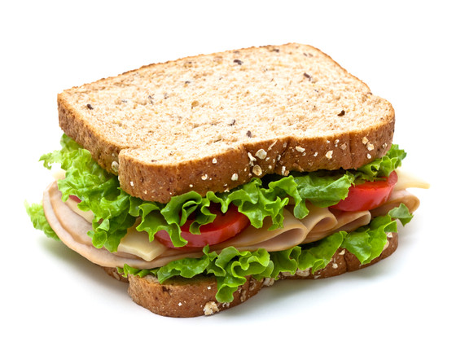
Jason’s sandwich

Slide 5
Jason’s sandwich
Suppose that Jason has the following ingredients to make a sandwich with:
White or black bread
Butter, Mayo or Honey Mustard
Romaine Lettuce, Spinach, Kale
Bologna, Ham or Turkey
Tomato or egg slices

Slide 6
Jason’s sandwich
Suppose that Jason has the following ingredients to make a sandwich with:
White or black bread
Butter, Mayo or Honey Mustard
Romaine Lettuce, Spinach, Kale
Bologna, Ham or Turkey
Tomato or egg slices
How many different sandwiches can Jason make?

Slide 7
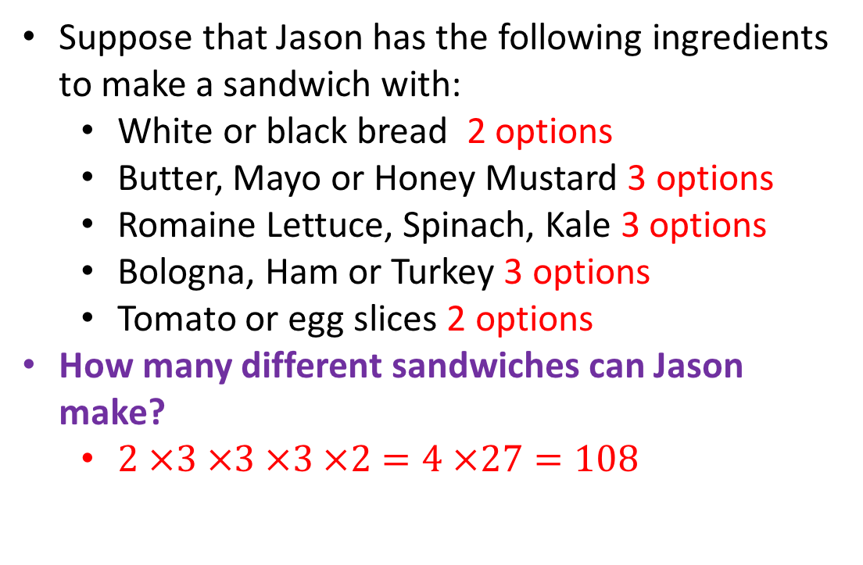
Jason’s sandwich
Suppose that Jason has the following ingredients to make a sandwich with:
White or black bread 2 options
Butter, Mayo or Honey Mustard 3 options
Romaine Lettuce, Spinach, Kale 3 options
Bologna, Ham or Turkey 3 options
Tomato or egg slices 2 options
How many different sandwiches can Jason make?
$2 ×3 ×3 ×3 ×2=4 ×27=108$

Slide 8
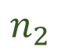
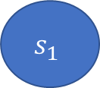
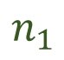
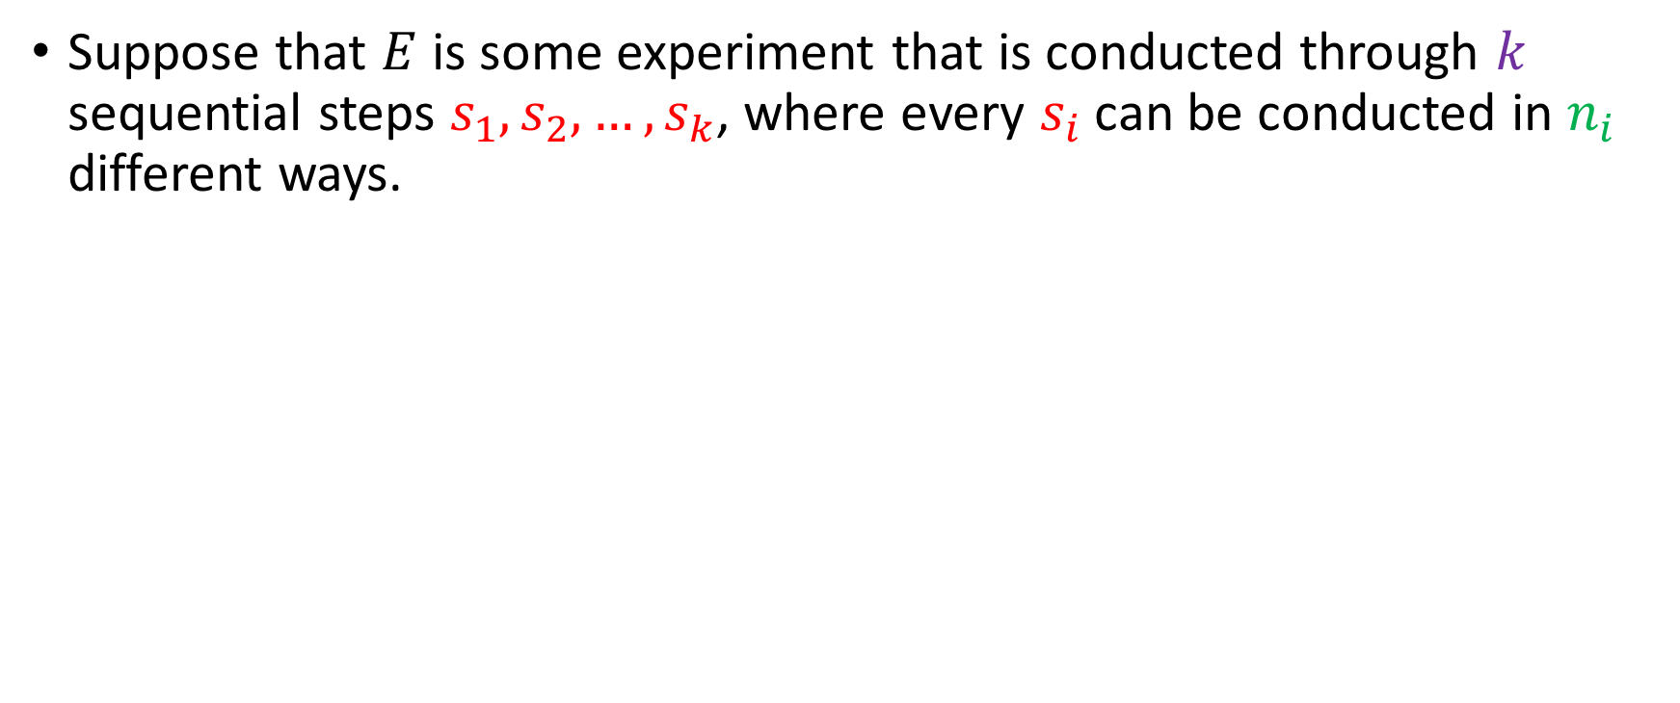
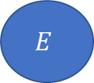

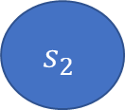
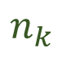
The multiplication rule
Suppose that $E$ is some experiment that is conducted through $k$ sequential steps $s_{1}, s_{2},…,s_{k}$, where every $s_{i}$ can be conducted in $n_{i}$ different ways.
$$s_{1}$$
$$s_{2}$$
$$s_{k}$$
$$E$$
$$n_{1}$$
$$n_{2}$$
$$n_{k}$$

Slide 9
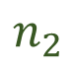

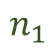
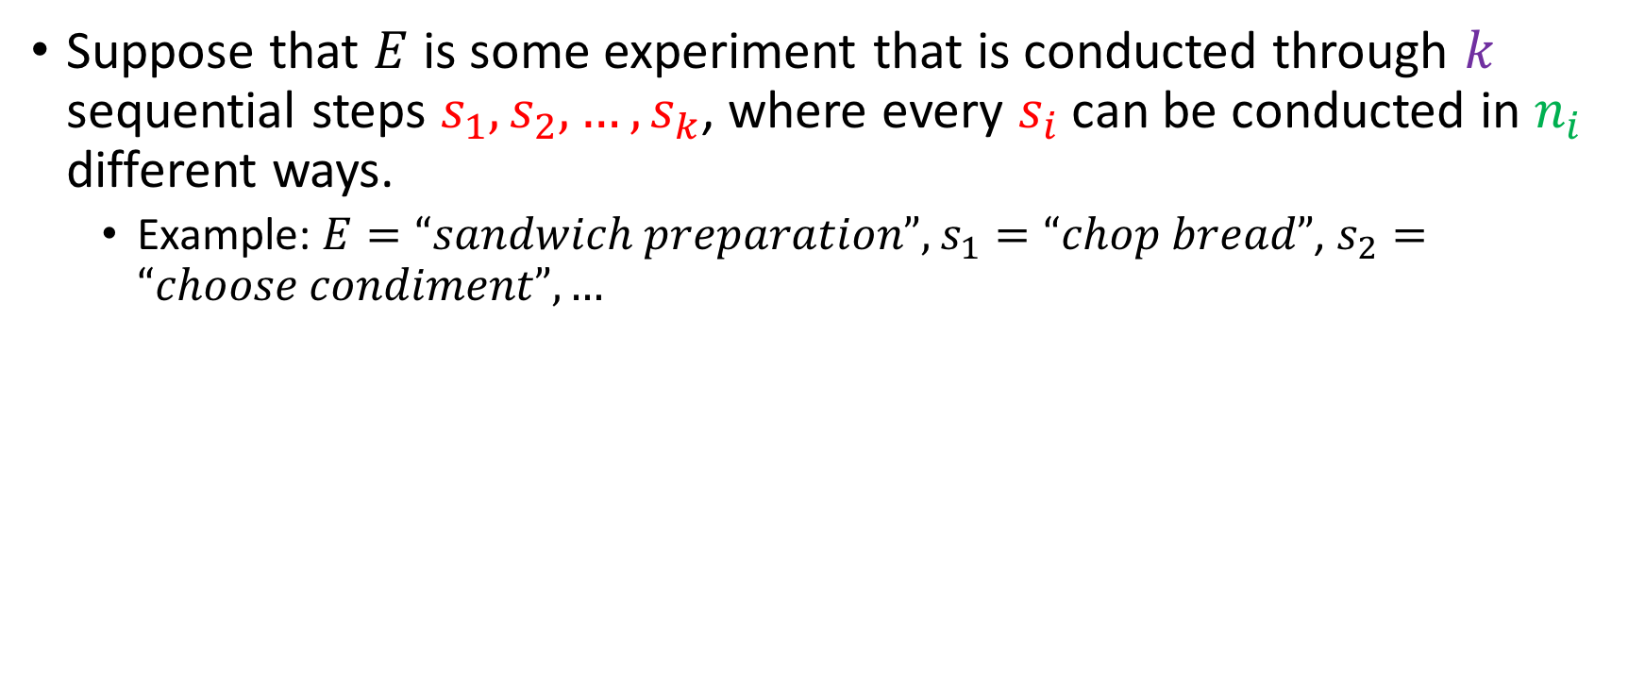

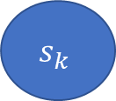


The multiplication rule
Suppose that $E$ is some experiment that is conducted through $k$ sequential steps $s_{1}, s_{2},…,s_{k}$, where every $s_{i}$ can be conducted in $n_{i}$ different ways.
Example: $E=“sandwich preparation”,$ $s_{1}=“chop bread”$, $s_{2}=“choose condiment”, …$
$$s_{1}$$
$$s_{2}$$
$$s_{k}$$
$$E$$
$$n_{1}$$
$$n_{2}$$
$$n_{k}$$

Slide 10


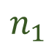
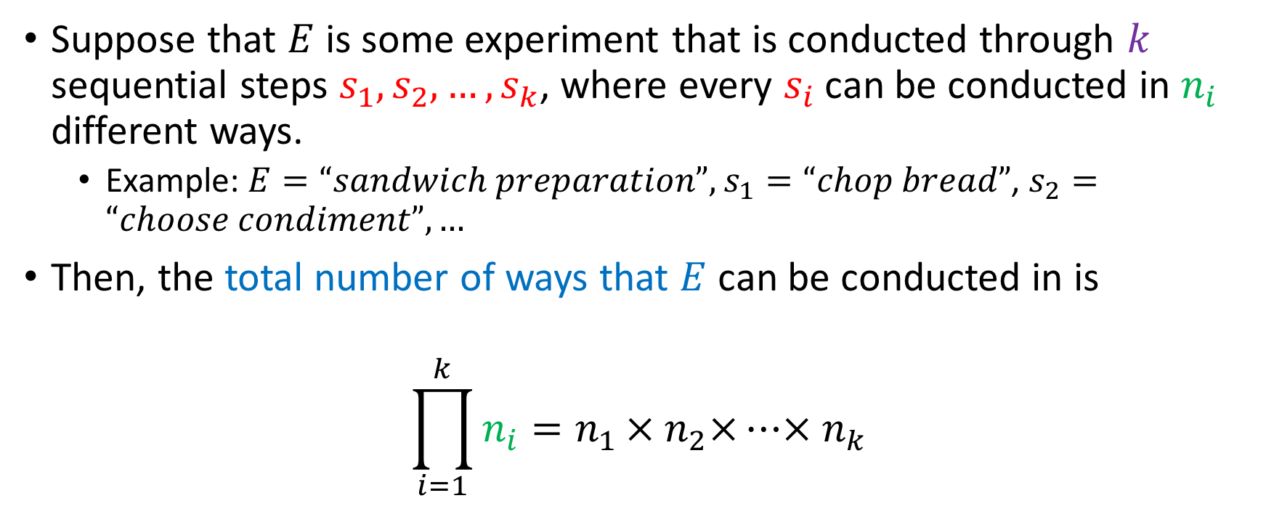
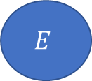



The multiplication rule
Suppose that $E$ is some experiment that is conducted through $k$ sequential steps $s_{1}, s_{2},…,s_{k}$, where every $s_{i}$ can be conducted in $n_{i}$ different ways.
Example: $E=“sandwich preparation”,$ $s_{1}=“chop bread”$, $s_{2}=“choose condiment”, …$
Then, the total number of ways that $E$ can be conducted in is
$$\prod_{i=1}^{k}{n_{i}}=n_{1 }× n_{2}×…× n_{k}$$
$$s_{1}$$
$$s_{2}$$
$$s_{k}$$
$$E$$
$$n_{1}$$
$$n_{2}$$
$$n_{k}$$

Slide 11
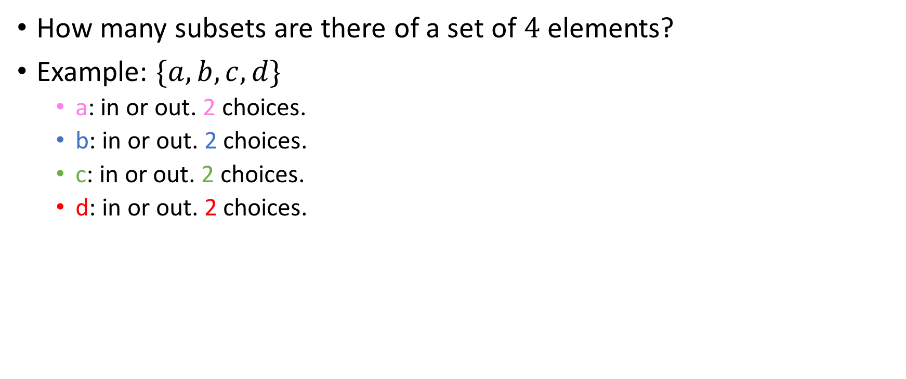
A familiar example
How many subsets are there of a set of $4$ elements?
Example: $\{a, b, c, d\}$
a: in or out. 2 choices.
b: in or out. 2 choices.
c: in or out. 2 choices.
d: in or out. 2 choices.

Slide 12
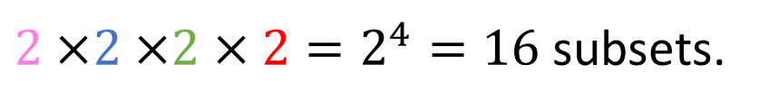
A familiar example
How many subsets are there of a set of $4$ elements?
Example: $\{a, b, c, d\}$
a: in or out. 2 choices.
b: in or out. 2 choices.
c: in or out. 2 choices.
d: in or out. 2 choices.
$2 ×2 ×2 × 2=2^{4}=16$ subsets.

Slide 13

A familiar example
How many subsets are there of a set of $4$ elements?
Example: $\{a, b, c, d\}$
a: in or out. 2 choices.
b: in or out. 2 choices.
c: in or out. 2 choices.
d: in or out. 2 choices.
Generalization: there are $2^{n}$ subsets of a set of size $n$.
But you already knew this.
$2 ×2 ×2 × 2=2^{4}=16$ subsets.

Slide 14
Picking projects
Murad is taking CMSC420 (Data Structures)
He has to pick three projects total for the course.
The CMSC 420 projects are divided into three categories.

Slide 15
Picking projects
Murad is taking CMSC420 (Data Structures)
He has to pick three projects total for the course.
The CMSC 420 projects are divided into three categories.
Hashing (20 projects available),

Slide 16
Picking projects
Murad is taking CMSC420 (Data Structures)
He has to pick three projects total for the course.
The CMSC 420 projects are divided into three categories.
Hashing (20 projects available),
Multi-Dimensional Indexing(15 projects available)

Slide 17
Picking projects
Murad is taking CMSC420 (Data Structures)
He has to pick three projects total for the course.
The CMSC 420 projects are divided into three categories.
Hashing (20 projects available),
Multi-Dimensional Indexing (15 projects available)
Data Compression (40 data compression projects available).

Slide 18
Picking projects
Murad is taking CMSC420 (Data Structures)
He has to pick three projects total for the course.
The CMSC 420 projects are divided into three categories.
Hashing (20 projects available),
Multi-Dimensional Indexing (15 projects available)
Data Compression (40 data compression projects available).
In how many different ways can Murad pick all his projects?

Slide 19
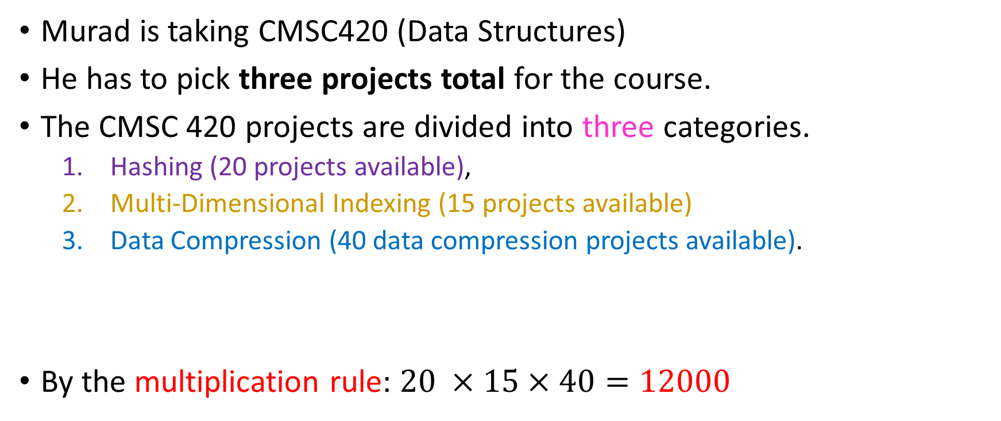
Picking projects
Murad is taking CMSC420 (Data Structures)
He has to pick three projects total for the course.
The CMSC 420 projects are divided into three categories.
Hashing (20 projects available),
Multi-Dimensional Indexing (15 projects available)
Data Compression (40 data compression projects available).
By the multiplication rule: $20 ×15×40=12000$
In how many different ways can Murad pick a project?

Slide 20
Picking projects
Suppose now that Murad has to pick one project for CMSC420.
Categories are the same:
Hashing (20 projects available),
Multi-Dimensional Indexing (15 projects available)
Data Compression (40 data compression projects available).

Slide 21
Picking projects
Suppose now that Murad has to pick one project for CMSC420.
Categories are the same:
Hashing (20 projects available),
Multi-Dimensional Indexing (15 projects available)
Data Compression (40 data compression projects available).
In how many different ways can Murad pick a project now?

Slide 22
Picking projects
Suppose now that Murad has to pick one project for CMSC420.
Categories are the same:
Hashing (20 projects available),
Multi-Dimensional Indexing (15 projects available)
Data Compression (40 data compression projects available).
There are 20 + 15 + 40 = 75 projects available, so 75 different ways.
In how many different ways can Murad pick a project now?

Slide 23
Picking projects
Suppose now that Murad has to pick one project for CMSC420.
Categories are the same:
Hashing (20 projects available),
Multi-Dimensional Indexing (15 projects available)
Data Compression (40 data compression projects available).
There are 20 + 15 + 40 = 75 projects available, so 75 different ways.
Note that if a project was shared between two categories, we’d have an overcount! (74 instead of 75)
It is your responsibility to be able to understand when an overcount occurs in a question!
In how many different ways can Murad pick a project now?

Slide 24

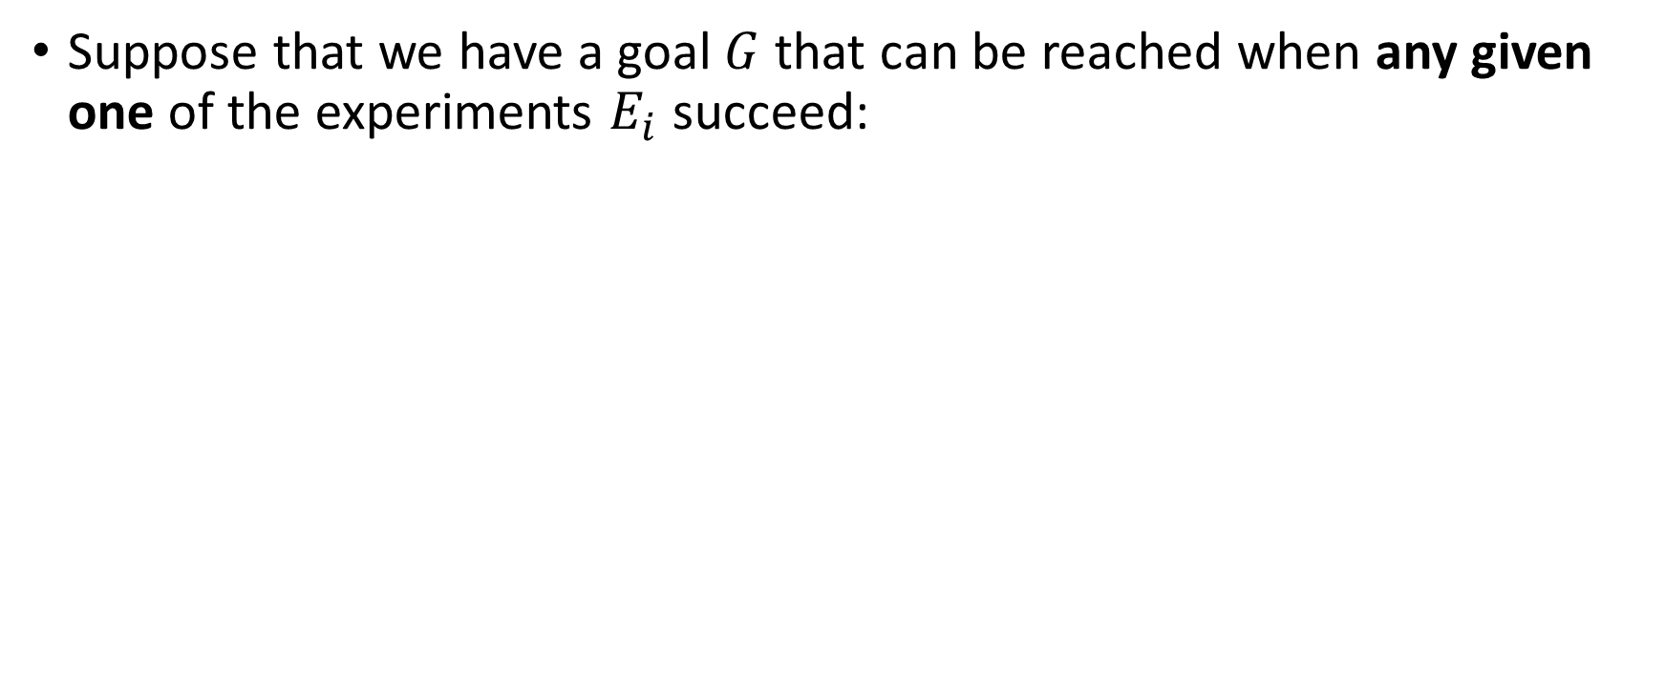

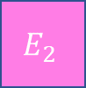

Addition (sum) rule
Suppose that we have a goal $G$ that can be reached when any given one of the experiments $E_{i}$ succeed:
$$G$$
$$E_{1}$$
$$E_{2}$$
$$E_{k}$$

Slide 25
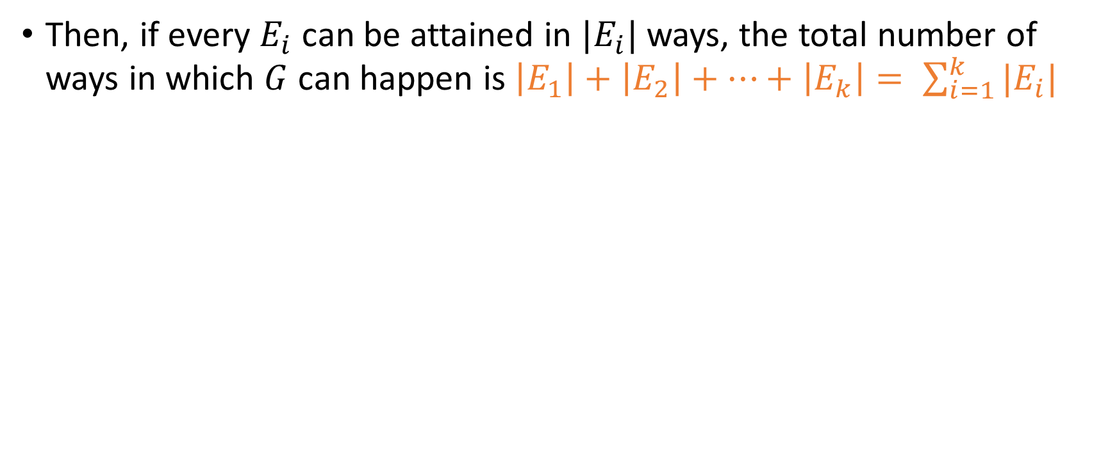
Addition (sum) rule
Then, if every $E_{i}$ can be attained in $|E_{i}|$ ways, the total number of ways in which $G$ can happen is $\left|E_{1}\right|+\left|E_{2}\right|+…+\left|E_{k}\right|= \sum_{i=1}^{k}{|E_{i}|}$
$$G$$
$$E_{1}$$
$$E_{2}$$
$$E_{k}$$

Slide 26

Subtraction rule

Slide 27
Permutations
The problem of finding a permutation of a string is a classic application of the multiplication rule.
Consider the string “machinery”.
A permutation of “machinery” is a string which results by re-organizing the characters of “machinery” around.
Examples: chyirenma, hcyranemi, machinery (!)
Question: How many permutations of “machinery” are there?

Slide 28
# Permutations
m a c h i n e r y
_ _ _ _ _ _ _ _ _
9 options for ‘m’

Slide 29
# Permutations
m a c h i n e r y
_ _ m _ _ _ _ _ _
9 options for ‘m’

Slide 30
# Permutations
m a c h i n e r y
_ _ m _ _ _ _ _ _
8 options for ‘a’

Slide 31
# Permutations
m a c h i n e r y
_ _ m _ _ _ a _ _
8 options for ‘a’

Slide 32
# Permutations
m a c h i n e r y
_ _ m _ _ _ a _ _
7 options for ‘c’…

Slide 33
# Permutations
m a c h i n e r y
_ _ m _ _ c a _ _
7 options for ‘c’…

Slide 34
# Permutations
m a c h i n e r y
_ _ m _ _ c a _ _
6 options for ‘h’…

Slide 35
# Permutations
m a c h i n e r y
h _ m _ _ c a _ _
6 options for ‘h’…

Slide 36
# Permutations
m a c h i n e r y
h _ m _ _ c a _ _
5 options for ‘i’

Slide 37
# Permutations
m a c h i n e r y
h _ m _ _ c a _ i
5 options for ‘i’

Slide 38
# Permutations
m a c h i n e r y
h _ m _ _ c a _ i
4 options for ‘n’

Slide 39
# Permutations
m a c h i n e r y
h _ m _ n c a _ i
4 options for ‘n’

Slide 40
# Permutations
m a c h i n e r y
h _ m _ n c a _ i
3 options for ‘e’

Slide 41
# Permutations
m a c h i n e r y
h e m _ n c a _ i
3 options for ‘e’

Slide 42
# Permutations
m a c h i n e r y
h e m _ n c a _ i
2 options for ‘r’

Slide 43
# Permutations
m a c h i n e r y
h e m _ n c a r i
2 options for ‘r’

Slide 44
# Permutations
m a c h i n e r y
h e m _ n c a r i
1 option for ‘y’

Slide 45
# Permutations
m a c h i n e r y
h e m y n c a r i
1 option for ‘y’

Slide 46
# Permutations
m a c h i n e r y
h e m y n c a r i
1 option for ‘y’
Total #possible permutations = $9 ×8 ×…×2 ×1=9!=362880$

Slide 47

# Permutations
m a c h i n e r y
h e m y n c a r i
1 option for ‘y’
Total #possible permutations = $9 ×8 ×…×2 ×1=9!=362880$
That’s a lot! (Original string has length 9)

Slide 48
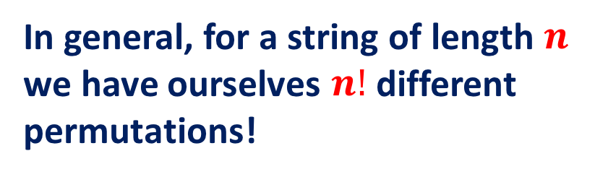
# Permutations
m a c h i n e r y
h e m y n c a r i
1 option for ‘y’
Total #possible permutations = $9 ×8 ×…×2 ×1=9!=362880$
In general, for a string of length $n$ we have ourselves $n!$ different permutations!
That’s a lot! (Original string has length 9)

Slide 49
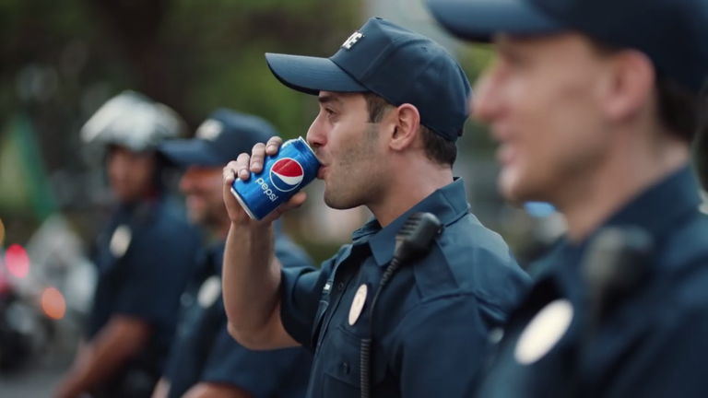
Break!

Slide 50
Permutations
Now, consider the string “puzzle”.
How many permutations are there of this string?
Note that two letters in puzzle are the same.

Slide 51
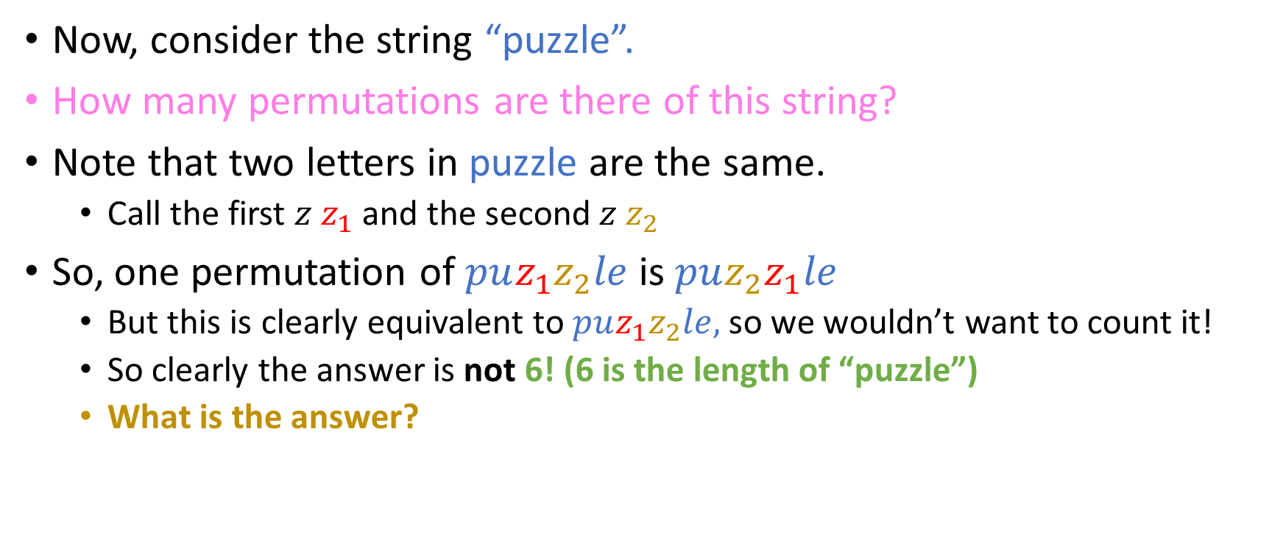
Permutations
Now, consider the string “puzzle”.
How many permutations are there of this string?
Note that two letters in puzzle are the same.
Call the first $z z_{1}$ and the second $z z_{2}$
So, one permutation of $puz_{1}z_{2}le$ is $pu{z_{2}z}_{1}le$
But this is clearly equivalent to $puz_{1}z_{2}le,$ so we wouldn’t want to count it!
So clearly the answer is not 6! (6 is the length of “puzzle”)
What is the answer?

Slide 52
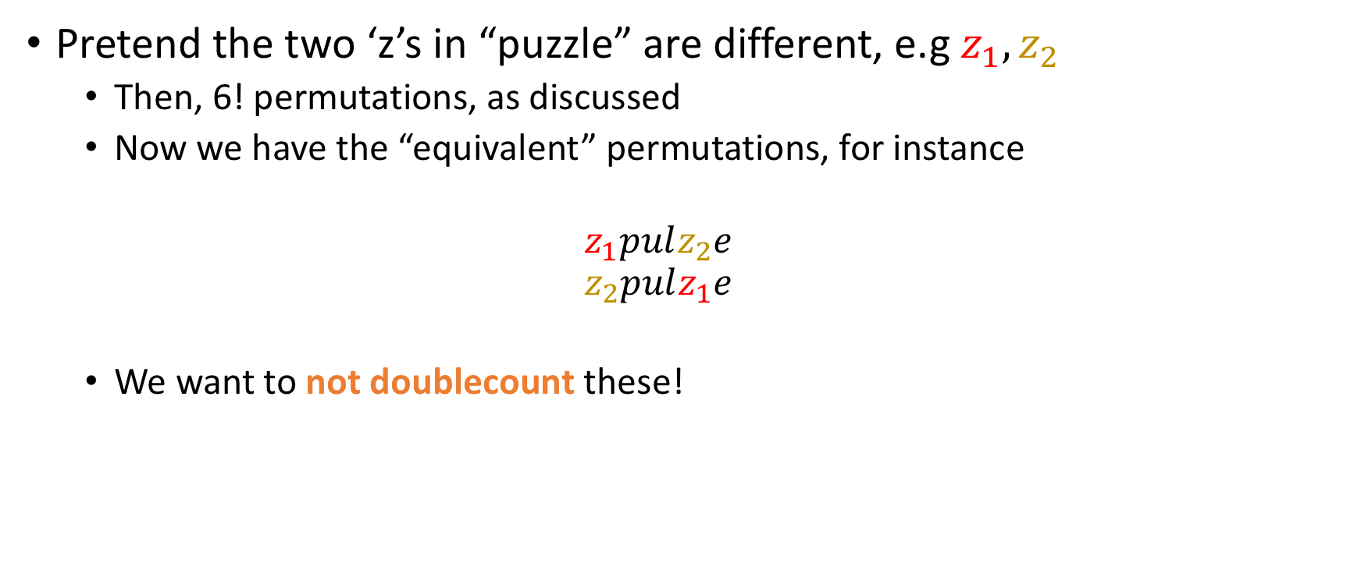
Thought Experiment
Pretend the two ‘z’s in “puzzle” are different, e.g $z_{1}, z_{2}$
Then, 6! permutations, as discussed
Now we have the “equivalent” permutations, for instance
$$z_{1}pulz_{2}e$$
$$z_{2}pulz_{1}e$$
We want to not doublecount these!

Slide 53
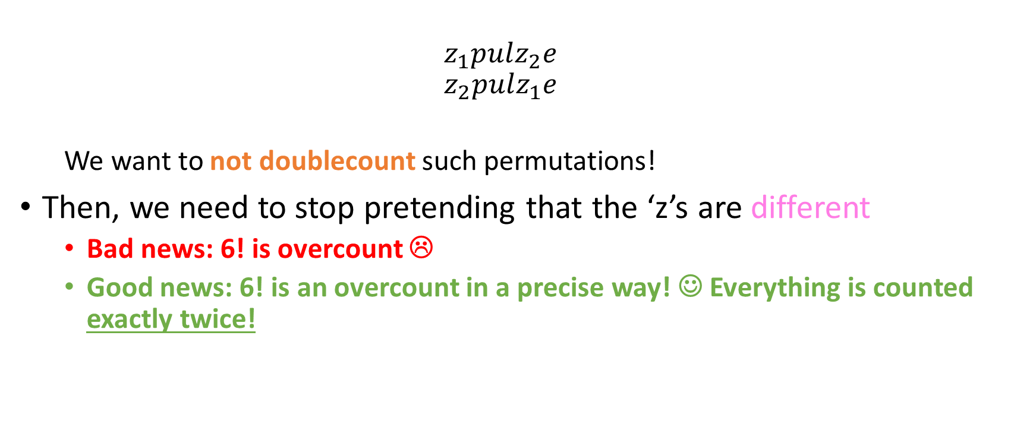
Thought Experiment
$$z_{1}pulz_{2}e$$
$$z_{2}pulz_{1}e$$
We want to not doublecount such permutations!
Then, we need to stop pretending that the ‘z’s are different
Bad news: 6! is overcount ☹
Good news: 6! is an overcount in a precise way! ☺ Everything is counted exactly twice!

Slide 54
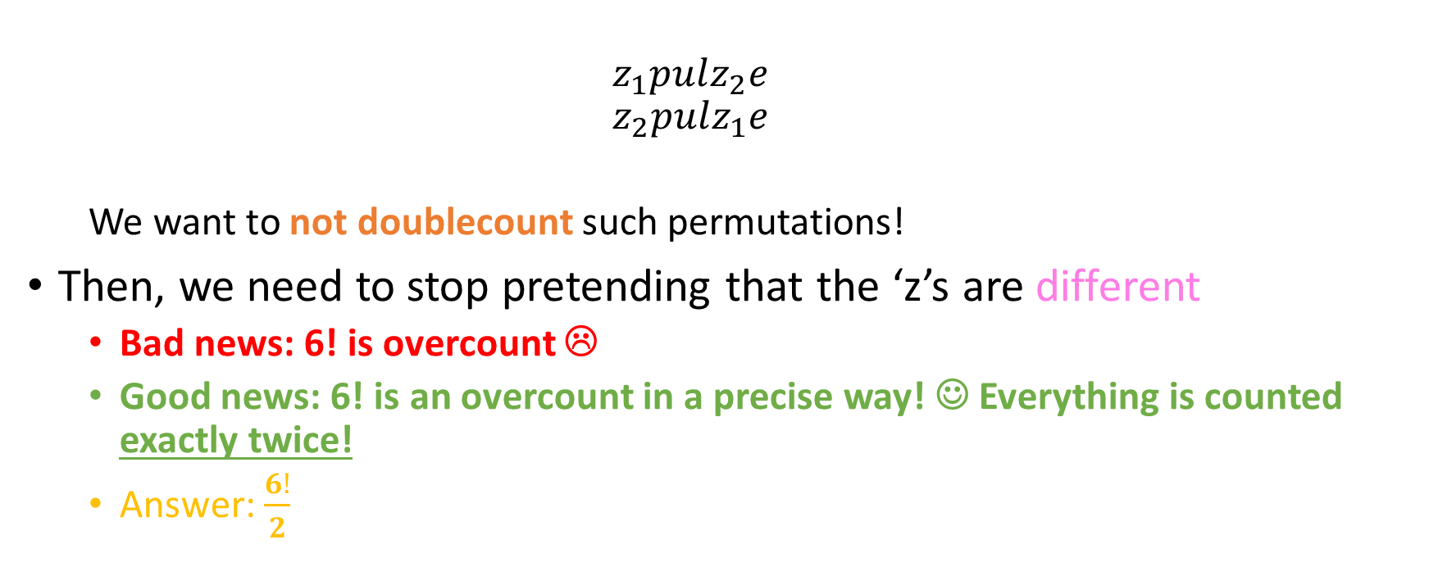
Thought Experiment
$$z_{1}pulz_{2}e$$
$$z_{2}pulz_{1}e$$
We want to not doublecount such permutations!
Then, we need to stop pretending that the ‘z’s are different
Bad news: 6! is overcount ☹
Good news: 6! is an overcount in a precise way! ☺ Everything is counted exactly twice!
Answer: $\frac{6!}{2}$

Slide 55
Permutations
Now, consider the string “scissor”.
How many permutations of “scissor” are there?
Note that three letters in “scissor” are the same.
As previously discussed, the answer cannot be 7! (7 is the length of “scissor”)

Slide 56
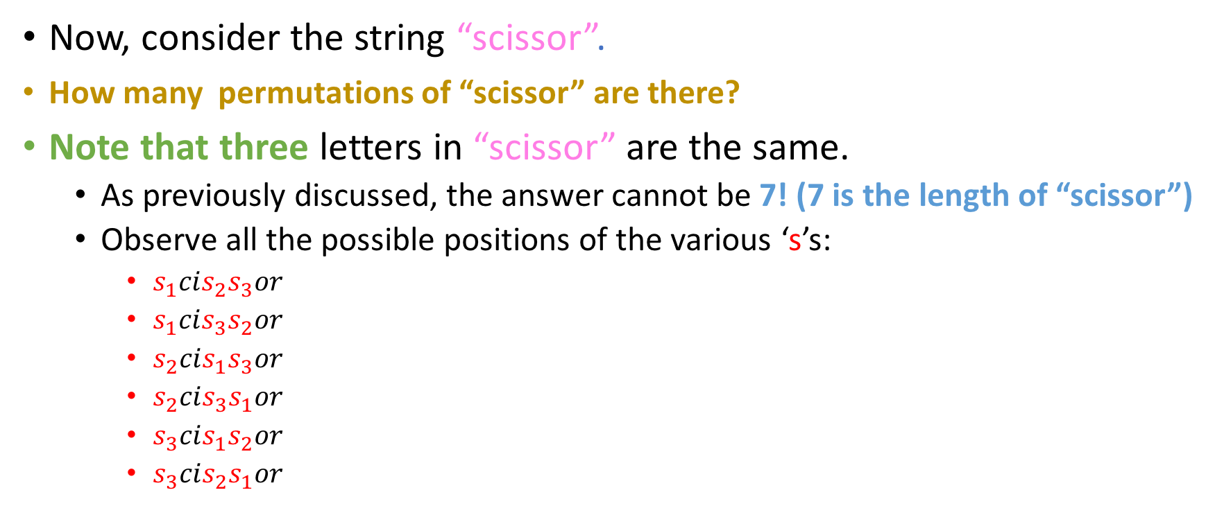
Permutations
Now, consider the string “scissor”.
How many permutations of “scissor” are there?
Note that three letters in “scissor” are the same.
As previously discussed, the answer cannot be 7! (7 is the length of “scissor”)
Observe all the possible positions of the various ‘s’s:
$s_{1}cis_{2}s_{3}or$
$s_{1}cis_{3}s_{2}or$
$s_{2}cis_{1}s_{3}or$
$s_{2}cis_{3}s_{1}or$
$s_{3}cis_{1}s_{2}or$
$s_{3}cis_{2}s_{1}or$

Slide 57
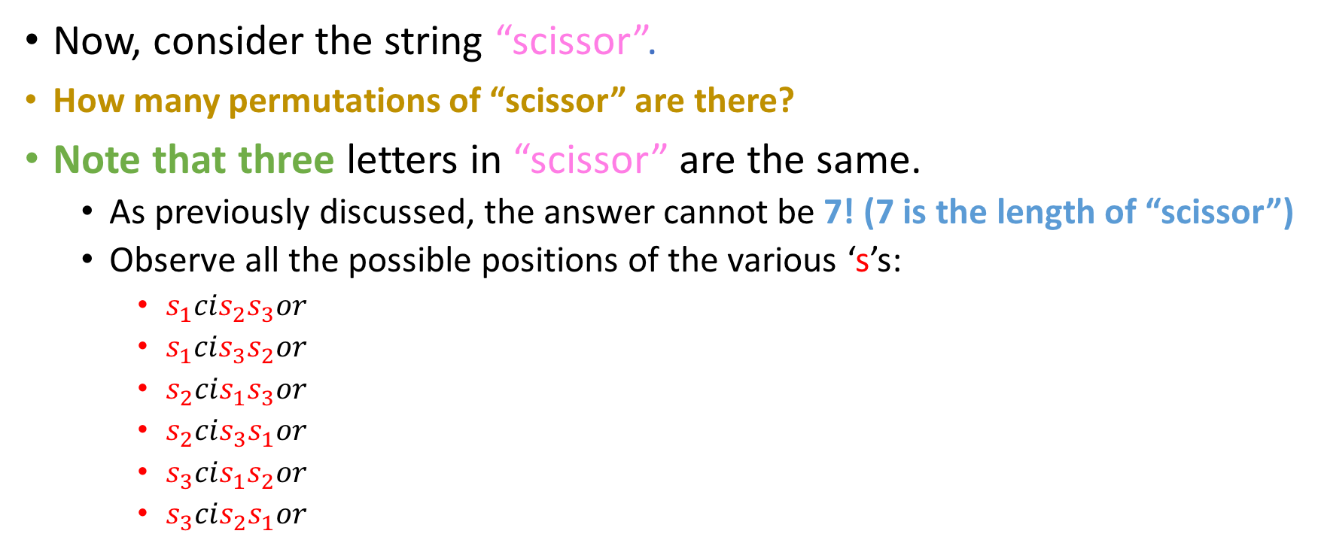
Permutations
Now, consider the string “scissor”.
How many permutations of “scissor” are there?
Note that three letters in “scissor” are the same.
As previously discussed, the answer cannot be 7! (7 is the length of “scissor”)
Observe all the possible positions of the various ‘s’s:
$s_{1}cis_{2}s_{3}or$
$s_{1}cis_{3}s_{2}or$
$s_{2}cis_{1}s_{3}or$
$s_{2}cis_{3}s_{1}or$
$s_{3}cis_{1}s_{2}or$
$s_{3}cis_{2}s_{1}or$
3! = 6 different ways to arrange those 3 ‘s’s

Slide 58
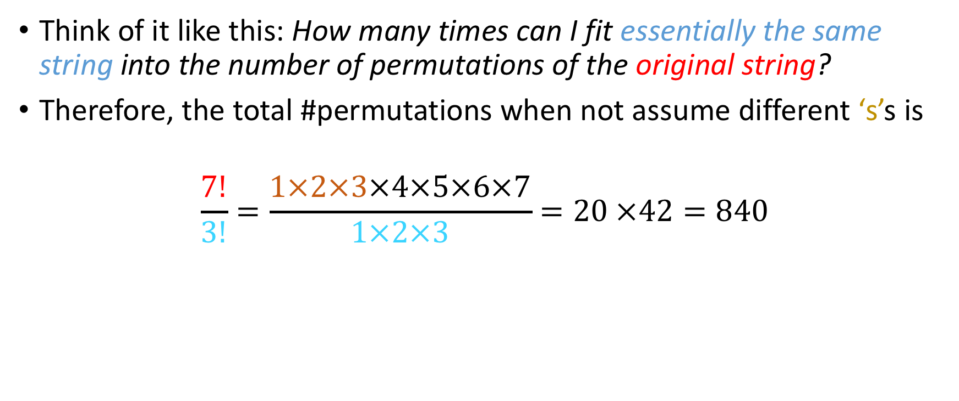
Final answer
Think of it like this: How many times can I fit essentially the same string into the number of permutations of the original string?
Therefore, the total #permutations when not assume different ‘s’s is
$$\frac{7!}{3!}=\frac{1×2×3×4×5×6×7}{1×2×3}=20 ×42=840$$

Slide 59
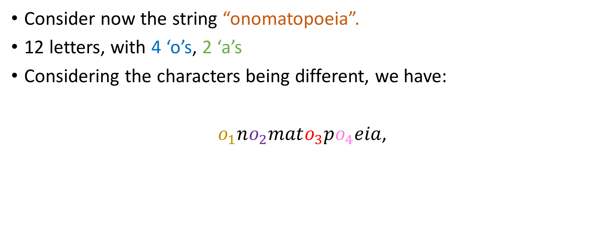
Complex overcounting
Consider now the string “onomatopoeia”.
12 letters, with 4 ‘o’s, 2 ‘a’s
Considering the characters being different, we have:
$o_{1}no_{2}mato_{3}po_{4}eia$,

Slide 60
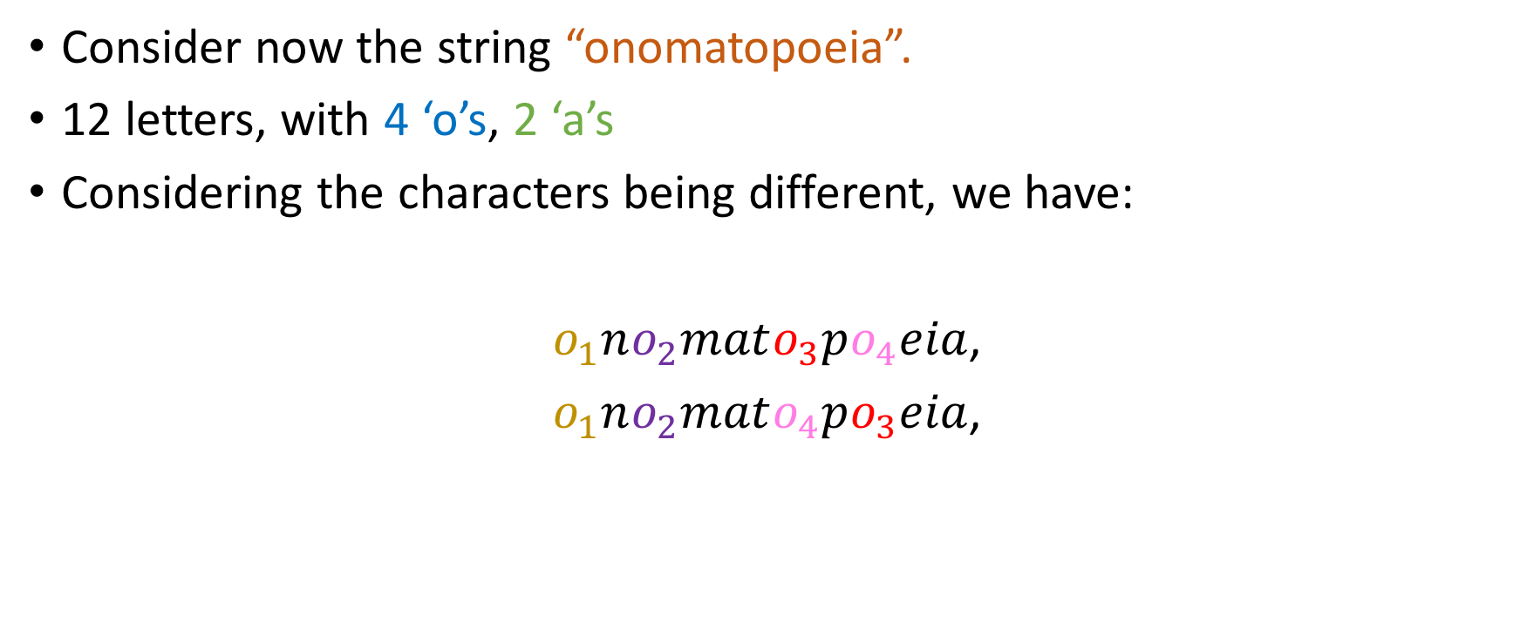
Complex overcounting
Consider now the string “onomatopoeia”.
12 letters, with 4 ‘o’s, 2 ‘a’s
Considering the characters being different, we have:
$o_{1}no_{2}mato_{3}po_{4}eia$,
$o_{1}no_{2}mato_{4}po_{3}eia$,

Slide 61
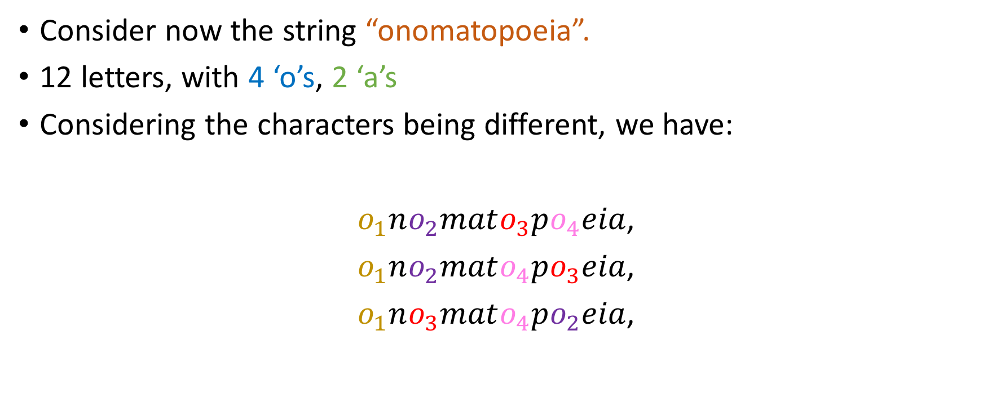
Complex overcounting
Consider now the string “onomatopoeia”.
12 letters, with 4 ‘o’s, 2 ‘a’s
Considering the characters being different, we have:
$o_{1}no_{2}mato_{3}po_{4}eia$,
$o_{1}no_{2}mato_{4}po_{3}eia$,
$o_{1}no_{3}mato_{4}po_{2}eia$,

Slide 62
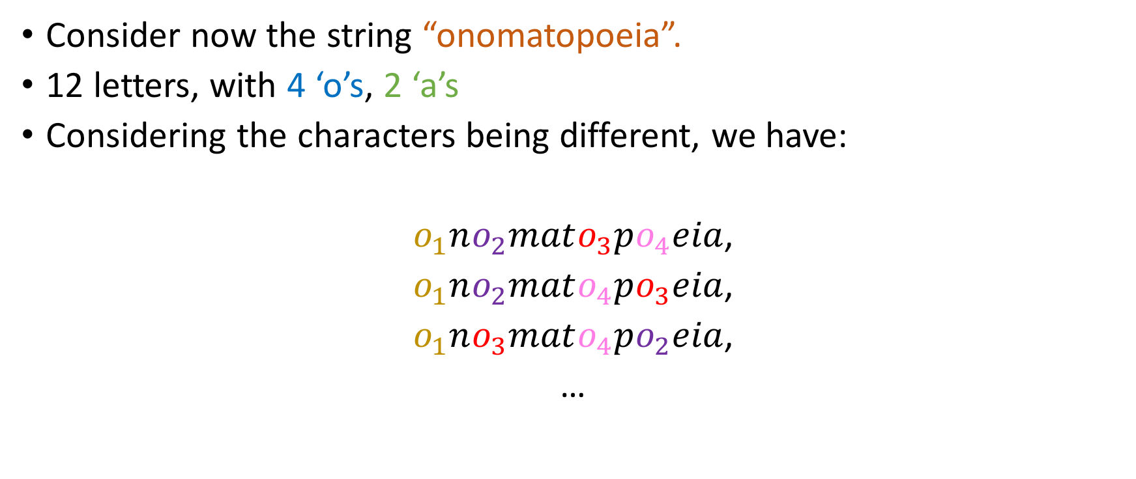
Complex overcounting
Consider now the string “onomatopoeia”.
12 letters, with 4 ‘o’s, 2 ‘a’s
Considering the characters being different, we have:
$o_{1}no_{2}mato_{3}po_{4}eia$,
$o_{1}no_{2}mato_{4}po_{3}eia$,
$o_{1}no_{3}mato_{4}po_{2}eia$,
…
How many such positionings of the ‘o’s are possible?
6
12
16
Something Else

Slide 63
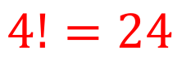
Complex overcounting
Consider now the string “onomatopoeia”.
12 letters, with 4 ‘o’s, 2 ‘a’s
Considering the characters being different, we have:
$o_{1}no_{2}mato_{3}po_{4}eia$,
$o_{1}no_{2}mato_{4}po_{3}eia$,
$o_{1}no_{3}mato_{4}po_{2}eia$,
…
How many such positionings of the ‘o’s are possible?
6
12
16
Something Else
$$4!=24$$
different ways.

Slide 64
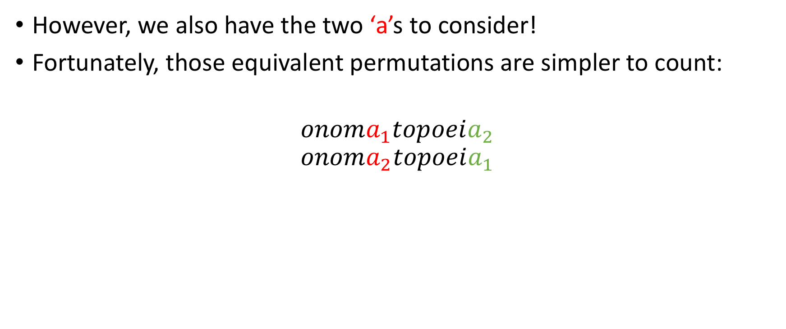
Complex overcounting
However, we also have the two ‘a’s to consider!
Fortunately, those equivalent permutations are simpler to count:
$$onoma_{1}topoeia_{2}$$
$$onoma_{2}topoeia_{1}$$

Slide 65
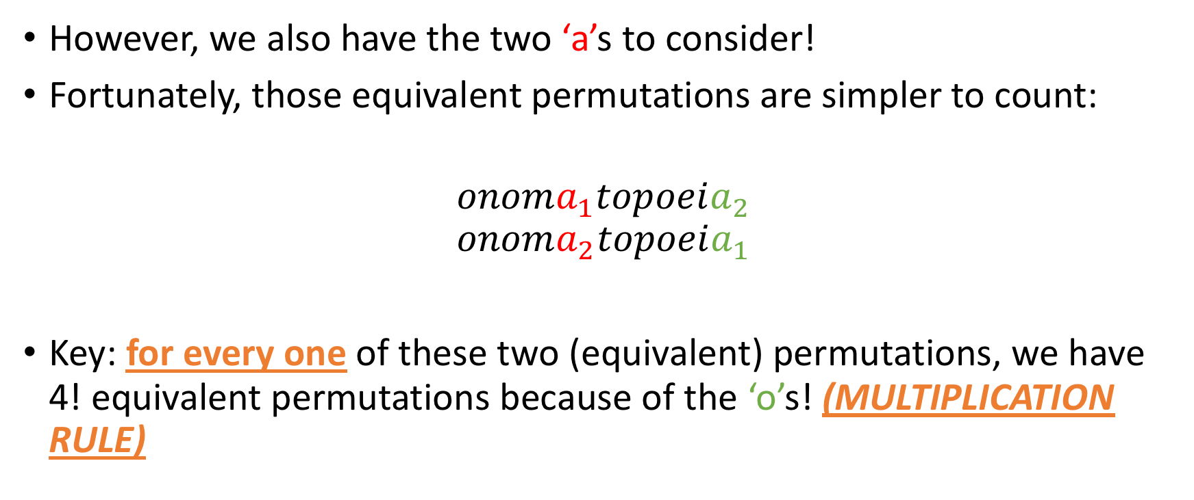
Complex overcounting
However, we also have the two ‘a’s to consider!
Fortunately, those equivalent permutations are simpler to count:
$$onoma_{1}topoeia_{2}$$
$$onoma_{2}topoeia_{1}$$
Key: for every one of these two (equivalent) permutations, we have 4! equivalent permutations because of the ‘o’s! (MULTIPLICATION RULE)

Slide 66
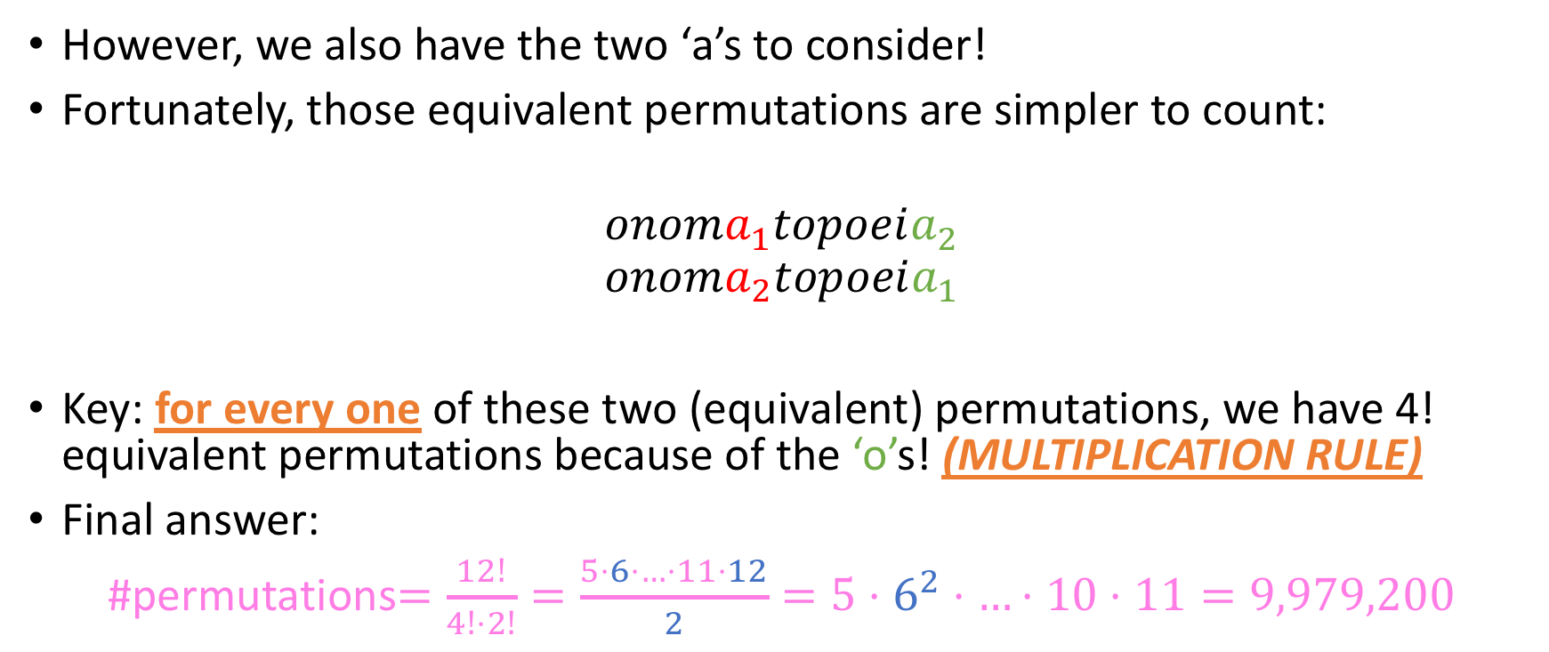
Complex overcounting
However, we also have the two ‘a’s to consider!
Fortunately, those equivalent permutations are simpler to count:
$$onoma_{1}topoeia_{2}$$
$$onoma_{2}topoeia_{1}$$
Key: for every one of these two (equivalent) permutations, we have 4! equivalent permutations because of the ‘o’s! (MULTIPLICATION RULE)
Final answer:
#permutations$=\frac{12!}{4!⋅2!}=\frac{5⋅6⋅…⋅11⋅12}{2}=5⋅6^{2}⋅…⋅10⋅11=9,979,200$

Slide 67
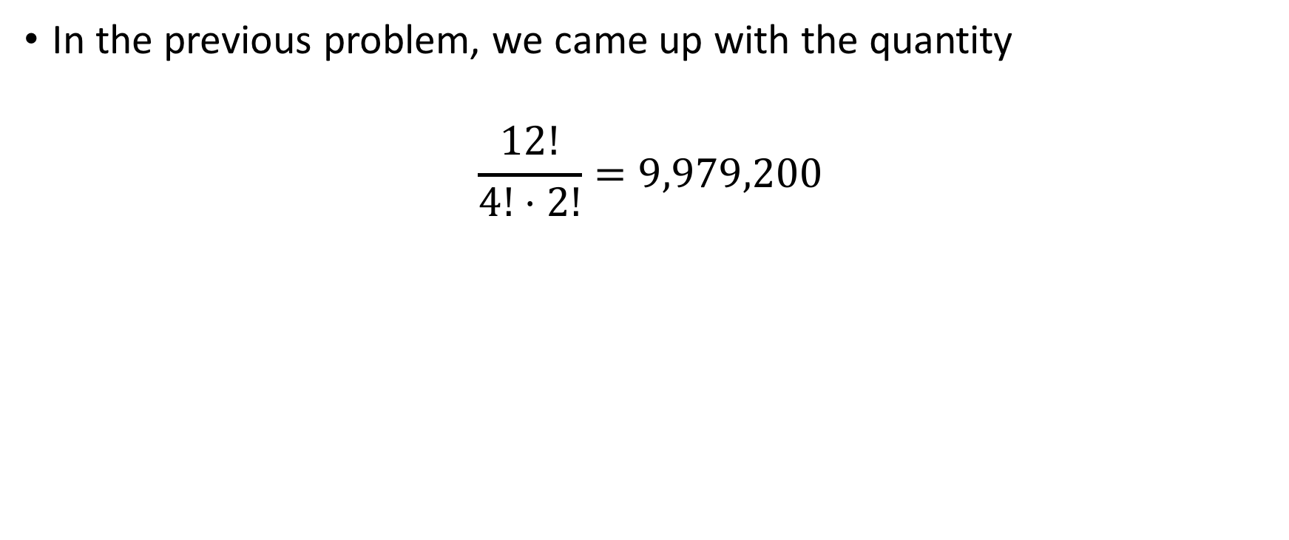
Important “pedagogical” note
In the previous problem, we came up with the quantity
$$\frac{12!}{4!⋅2!}=9,979,200$$

Slide 68
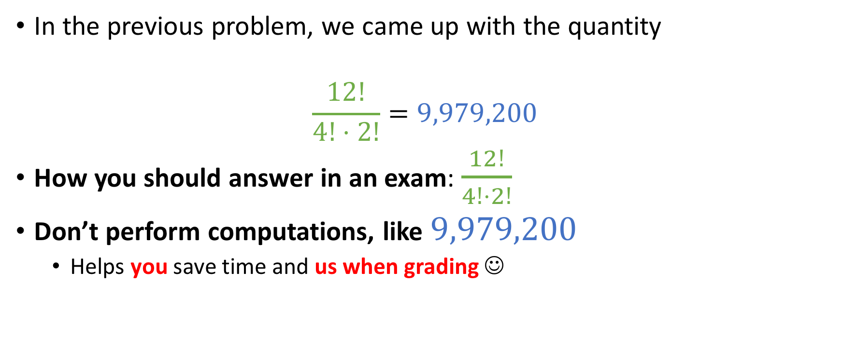
Important “pedagogical” note
In the previous problem, we came up with the quantity
$$\frac{12!}{4!⋅2!}=9,979,200$$
How you should answer in an exam: $\frac{12!}{4!⋅2!}$
Don’t perform computations, like $9,979,200$
Helps you save time and us when grading ☺

Slide 69
For you!
Consider the word “bookkeeper” (according to this website, the only unhyphenated word in English with three consecutive repeated letters)
How many non-equivalent permutations of “bookkeeper” exist?

Slide 70
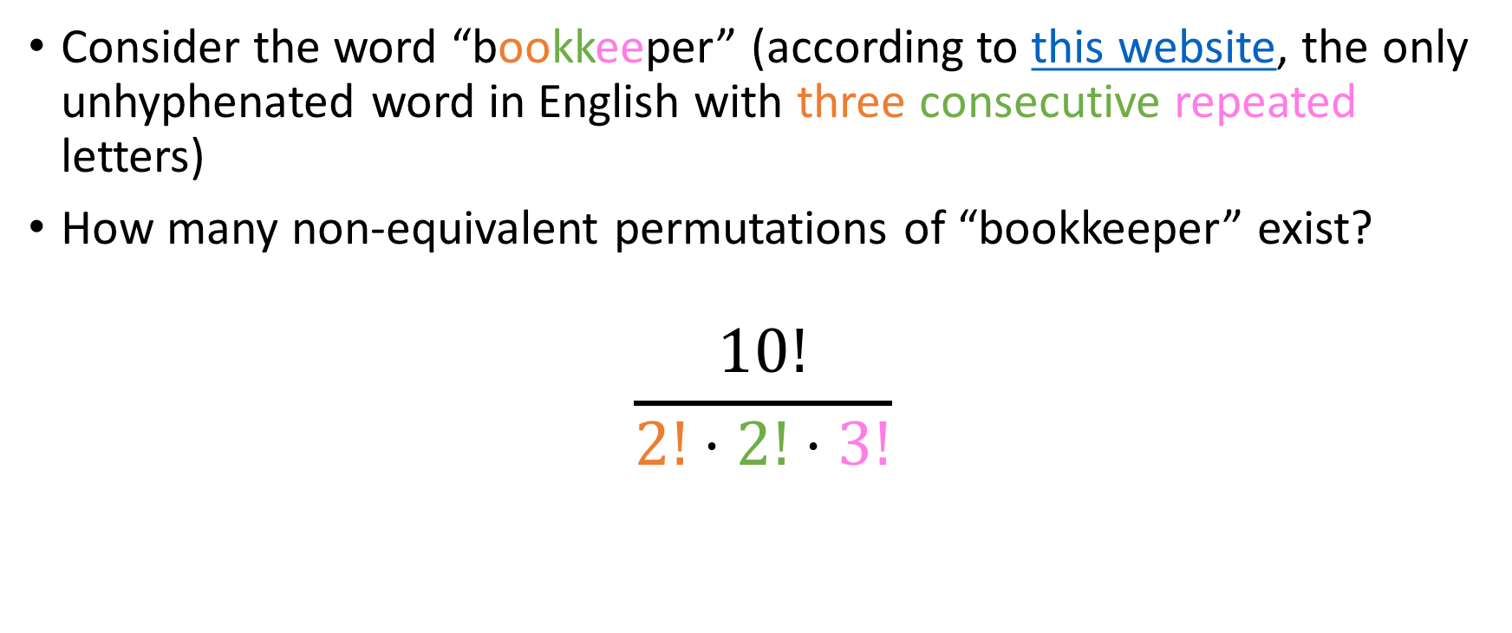
For you!
Consider the word “bookkeeper” (according to this website, the only unhyphenated word in English with three consecutive repeated letters)
How many non-equivalent permutations of “bookkeeper” exist?
$$\frac{10!}{2!⋅2!⋅3!}$$
Don’t forget the third ‘e’!

Slide 71
More practice
What about the #non-equivalent permutations for the word
combinatorics

Slide 72
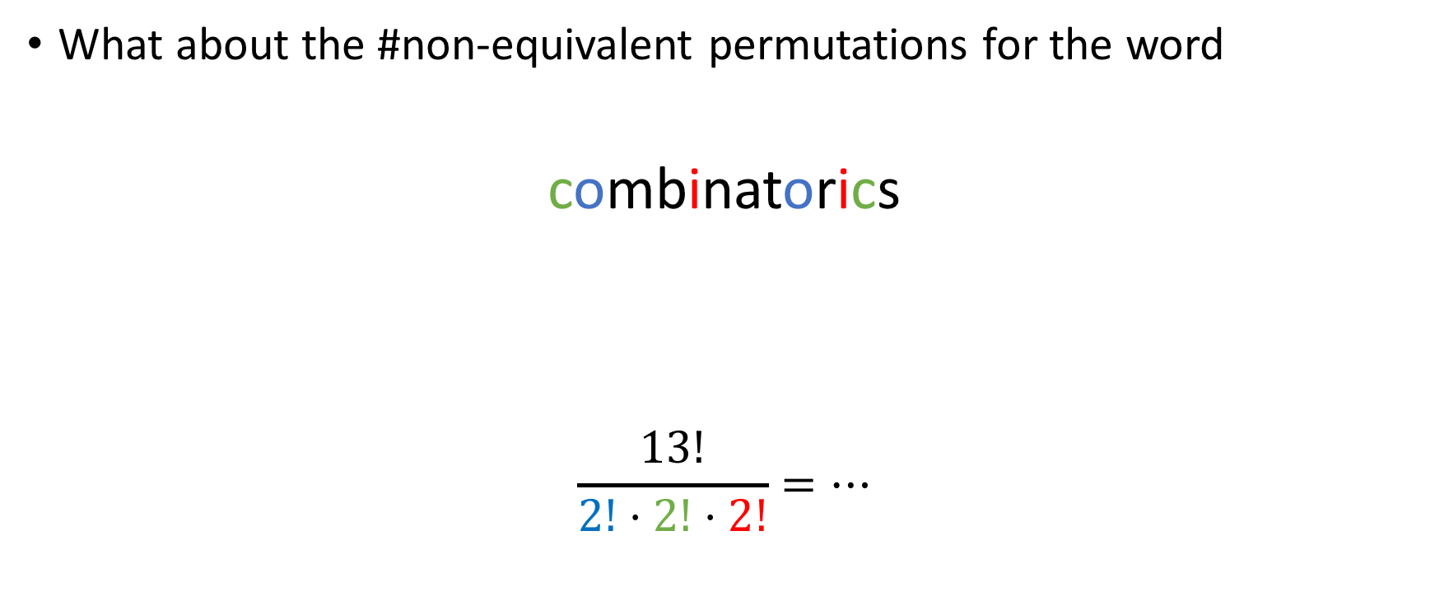
More practice
What about the #non-equivalent permutations for the word
combinatorics
$$\frac{13!}{2!⋅2!⋅2!}=…$$

Slide 73
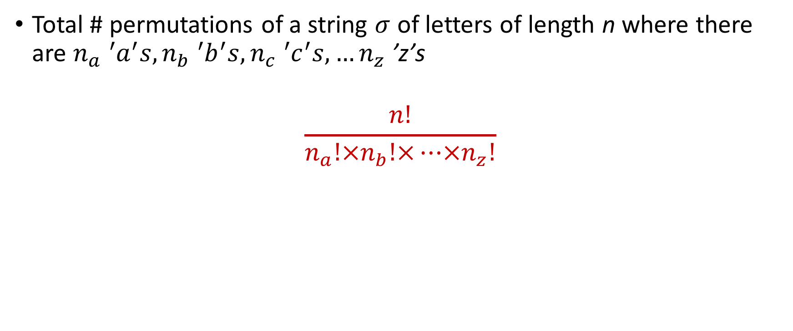
General template
Total # permutations of a string $σ$ of letters of length n where there are $n_{a} {{}_{ }^{′}a}^{′}s, n_{b} {{}_{ }^{′}b}^{′}s, n_{c} {{}_{ }^{′}c}^{′}s, …n_{z} \text{’}\text{z}\text{’}\text{s}$
$$\frac{n!}{n_{a}!×n_{b}!×…×n_{z}!}$$

Slide 74
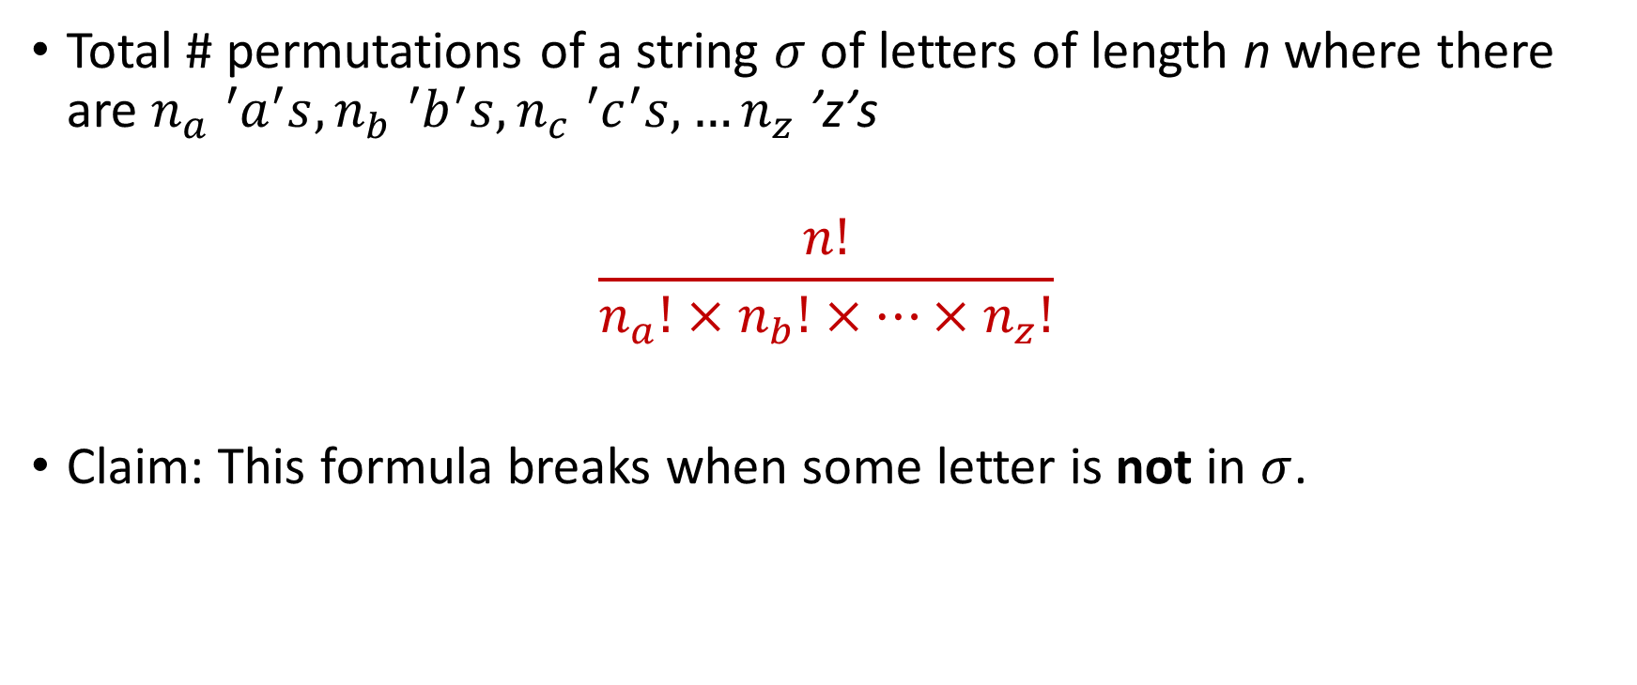
General template
Total # permutations of a string $σ$ of letters of length n where there are $n_{a} {{}_{ }^{′}a}^{′}s, n_{b} {{}_{ }^{′}b}^{′}s, n_{c} {{}_{ }^{′}c}^{′}s, …n_{z} \text{’}\text{z}\text{’}\text{s}$
$$\frac{n!}{n_{a}!×n_{b}!×…×n_{z}!}$$
Claim: This formula breaks when some letter is not in $σ$.
Yes
No

Slide 75


General template
Total # permutations of a string $σ$ of letters of length n where there are $n_{a} {{}_{ }^{′}a}^{′}s, n_{b} {{}_{ }^{′}b}^{′}s, n_{c} {{}_{ }^{′}c}^{′}s, …n_{z} \text{’}\text{z}\text{’}\text{s}$
$$\frac{n!}{n_{a}!×n_{b}!×…×n_{z}!}$$
Claim: This formula breaks when some letter is not in $σ$.
Remember:
0! = 1
Yes
No

Slide 76
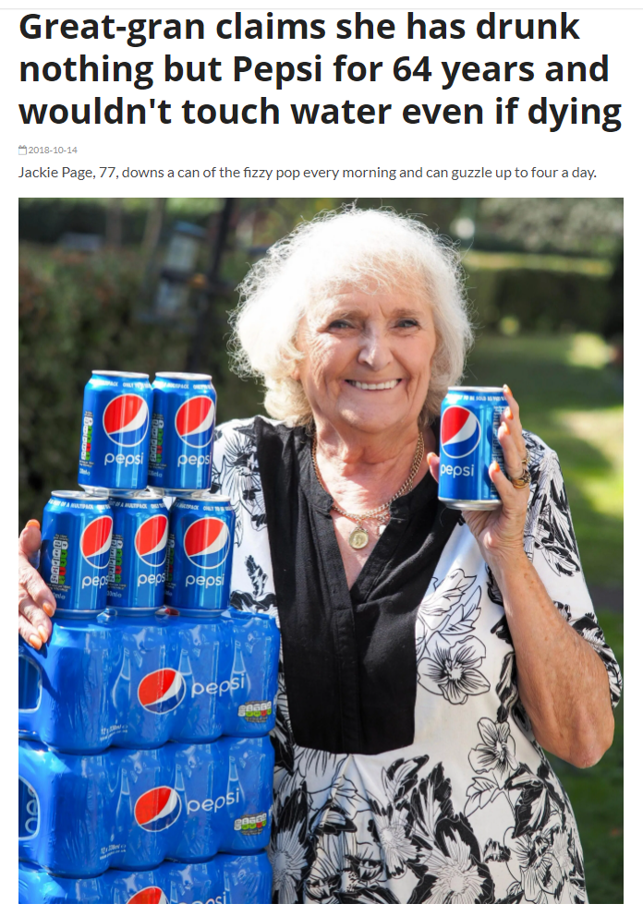
Sounds legit

Slide 77
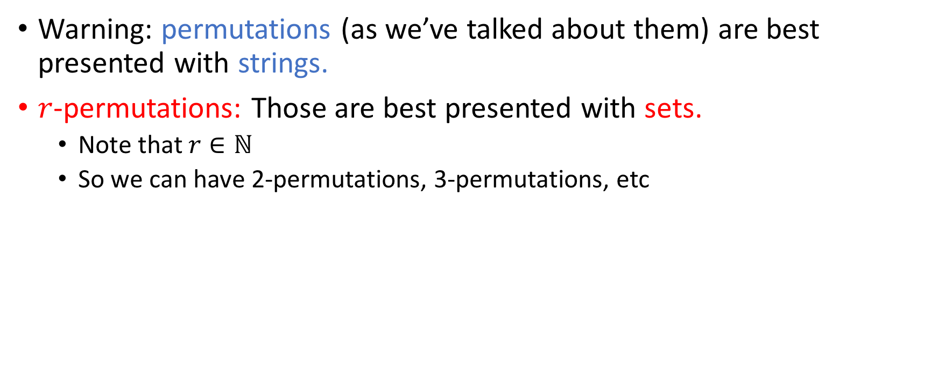

$r$-permutations
Warning: permutations (as we’ve talked about them) are best presented with strings.
$r$-permutations: Those are best presented with sets.
Note that $r∈ℕ$
So we can have 2-permutations, 3-permutations, etc

Slide 78


$r$-permutations: Example
I have ten people.
My goal: pick three people for a picture, where order of the people matters.

Slide 79
$r$-permutations: Example
I have ten people.
My goal: pick three people for a picture, where order of the people matters.
Examples: shortest-to-tallest or tallest-to-shortest or something-in-between

Slide 80
$r$-permutations: Example
I have ten people.
My goal: pick three people for a picture, where order of the people matters.
Examples: Jenny-Fred-Bob or Fred-Jenny-Bob or Fred-Bob-Jenny

Slide 81
$r$-permutations: Example
I have ten people.
My goal: pick three people for a picture, where order of the people matters.
In how many ways can I pick these people?

Slide 82

$r$-permutations: Example
I need three people for this photo. You guys figure out your order.

Slide 83
$r$-permutations: Example
I need three people for this photo. You guys figure out your order.

Slide 84
$r$-permutations: Example
10 ways to pick the first person…
I need three people for this photo. You guys figure out your order.
. . .

Slide 85
$r$-permutations: Example
10 ways to pick the first person…
I need three people for this photo. You guys figure out your order.

Slide 86

$r$-permutations: Example
10 ways to pick the first person…
I need three people for this photo. You guys figure out your order.

Slide 87
$r$-permutations: Example
9 ways to pick the second person…
I need three people for this photo. You guys figure out your order.
. . .

Slide 88
$r$-permutations: Example
9 ways to pick the second person…
I need three people for this photo. You guys figure out your order.

Slide 89

$r$-permutations: Example
9 ways to pick the second person…
I need three people for this photo. You guys figure out your order.

Slide 90
$r$-permutations: Example
8 ways to pick the third
person…
I need three people for this photo. You guys figure out your order.
. . .

Slide 91
$r$-permutations: Example
8 ways to pick the third
person…
I need three people for this photo. You guys figure out your order.

Slide 92

$r$-permutations: Example
8 ways to pick the third
person…
I need three people for this photo. You guys figure out your order.

Slide 93
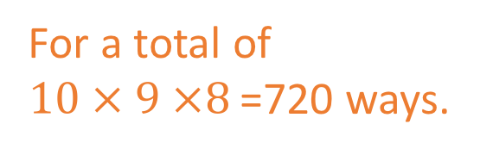
$r$-permutations: Example
I need three people for this photo. You guys figure out your order.
For a total of $10 × 9 ×8$ =720 ways.

Slide 94
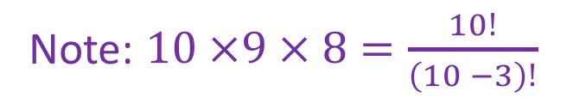
$r$-permutations: Example
I need three people for this photo. You guys figure out your order.
For a total of $10 × 9 ×8$ =720 ways.
Note: $10 ×9 × 8=\frac{10!}{\left(10 −3\right)!}$

Slide 95
Example on Books
Clyde has the following books on his bookshelf
Epp, Rosen, Hughes, Bogart, Davis, Shaffer, Sellers, Scott
Jason wants to borrow any 5 of them and read them in the order he picks them in.
In how many ways can Jason get smart by reading those books?

Slide 96
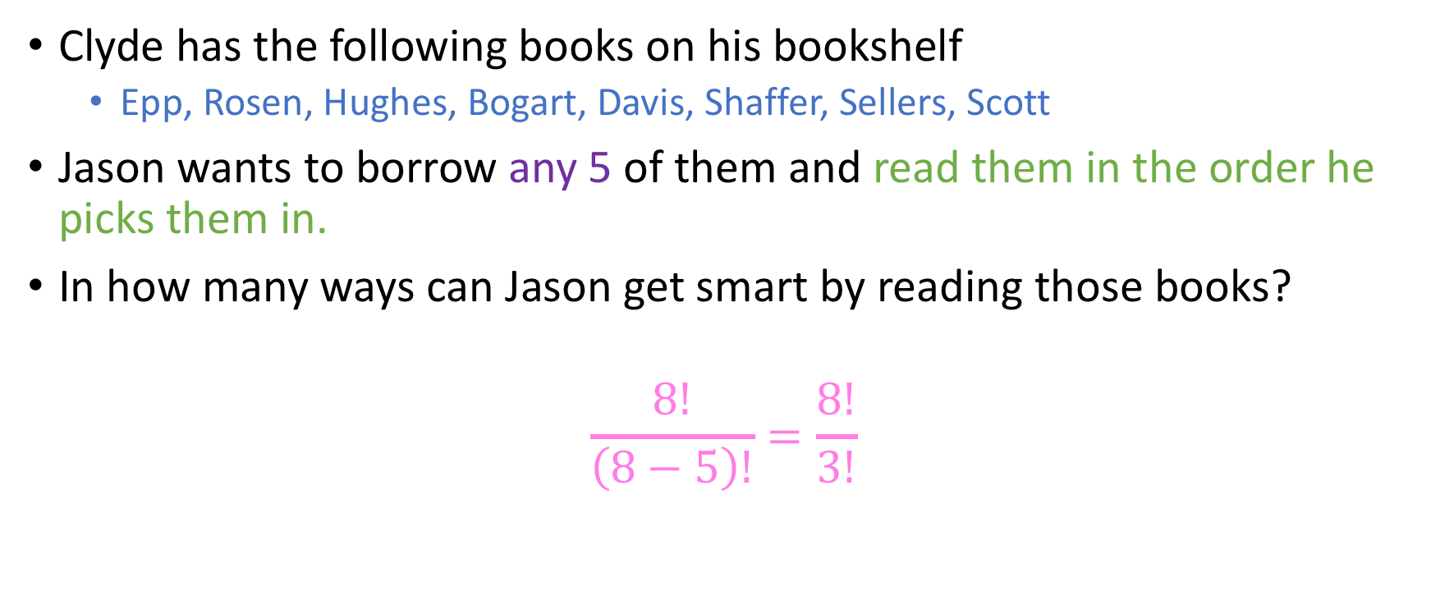
Example on Books
Clyde has the following books on his bookshelf
Epp, Rosen, Hughes, Bogart, Davis, Shaffer, Sellers, Scott
Jason wants to borrow any 5 of them and read them in the order he picks them in.
In how many ways can Jason get smart by reading those books?
$$\frac{8!}{\left(8−5\right)!}=\frac{8!}{3!}$$

Slide 97

General formula
Let $n, r∈ℕ^{ }$such that $0≤r≤n$. The total ways in which we can select $r$ elements from a set of $n$ elements where order matters is equal to:
$$P\left(n, r\right)=\frac{n!}{\left(n−r\right)!}$$

Slide 98
General formula
Let $n, r∈ℕ^{ }$such that $0≤r≤n$. The total ways in which we can select $r$ elements from a set of $n$ elements where order matters is equal to:
$$P\left(n, r\right)=\frac{n!}{\left(n−r\right)!}$$
‘’P” for permutation. This quantity is known as the $r$-permutations of a set with $n$ elements.

Slide 99



Pop quizzes
0
1
$$n$$
$$n!$$
$P\left(n, 1\right)=…$

Slide 100

Pop quizzes
0
1
$$n$$
$$n!$$
$P\left(n, 1\right)=…$
Two ways to convince yourselves:
Formula: $\frac{n!}{\left(n−1\right)!}=n$
Semantics of $r$-permutations: In how many ways can I pick 1 element from a set of $n$ elements? Clearly, I can pick any one of $n$ elements, so $n$ ways.

Slide 101

Pop quizzes
0
1
$$n$$
$$n!$$
$P\left(n, n\right)=…$

Slide 102

Pop quizzes
0
1
$$n$$
$$n!$$
$P\left(n, n\right)=…$
Again, two ways to convince ourselves:
Formula: $\frac{n!}{\left(n−n\right)!}=\frac{n!}{0!}$
Semantics: $n!$ ways to pick all of the elements of a set and put them in order!

Slide 103

Pop quizzes
0
1
$$n$$
$$n!$$
$P\left(n, 0\right)=…$

Slide 104

Pop quizzes
0
1
$$n$$
$$n!$$
$P\left(n, 0\right)=…$
Again, two ways to convince ourselves:
Formula: $\frac{n!}{\left(n−0\right)!}=\frac{n!}{n!}=1$
Semantics: Only one way to pick nothing: just pick nothing and leave!

Slide 105
Practice
How many MD license plates are possible to create?

Slide 106

Practice
How many MD license plates are possible to create? ${26}^{2}⋅{10}^{5}$

Slide 107

Practice
How many MD license plates are possible to create? ${26}^{2}⋅{10}^{5}$
How many ATM PINs are possible?

Slide 108

Practice
How many MD license plates are possible to create? ${26}^{2}⋅{10}^{5}$
How many ATM PINs are possible? ${10}^{4}$

Slide 109

Practice
How many MD license plates are possible to create? ${26}^{2}⋅{10}^{5}$
How many ATM PINs are possible? ${10}^{4}$
How many words of length 10 can I construct from the English alphabet, where letters can be chosen:

Slide 110

Practice
How many MD license plates are possible to create? ${26}^{2}⋅{10}^{5}$
How many ATM PINs are possible? ${10}^{4}$
How many words of length 10 can I construct from the English alphabet, where letters can be chosen:
With replacement (as in, I can reuse letters)

Slide 111

Practice
How many MD license plates are possible to create? ${26}^{2}⋅{10}^{5}$
How many ATM PINs are possible? ${10}^{4}$
How many words of length 10 can I construct from the English alphabet, where letters can be chosen:
With replacement (as in, I can reuse letters) ${26}^{10}$

Slide 112

Practice
How many MD license plates are possible to create? ${26}^{2}⋅{10}^{5}$
How many ATM PINs are possible? ${10}^{4}$
How many words of length 10 can I construct from the English alphabet, where letters can be chosen:
With replacement (as in, I can reuse letters) ${26}^{10}$
Without replacement (as in, I cannot reuse letters)

Slide 113

Practice
How many MD license plates are possible to create? ${26}^{2}⋅{10}^{5}$
How many ATM PINs are possible? ${10}^{4}$
How many words of length 10 can I construct from the English alphabet, where letters can be chosen:
With replacement (as in, I can reuse letters) ${26}^{10}$
Without replacement (as in, I cannot reuse letters) $P\left(26, 10\right) = \frac{26!}{16!}$

Slide 114

Practice
How many MD license plates are possible to create? ${26}^{2}⋅{10}^{5}$
How many ATM PINs are possible? ${10}^{4}$
How many words of length 10 can I construct from the English alphabet, where letters can be chosen:
With replacement (as in, I can reuse letters) ${26}^{10}$
Without replacement (as in, I cannot reuse letters) $P\left(26, 10\right) = \frac{26!}{16!}$
Remember these phrases!

Slide 115

Caption this

Slide 116
Combinations (that “n choose r” stuff)
Earlier, we discussed this example:
Our goal was to pick three people for a picture, where order of the people mattered.
I need three people for this photo. You guys figure out your order.

Slide 117

Combinations (that “n choose r” stuff)
Earlier, we discussed this example:
We now change this setup to forming a PhD defense committee (also 3 people).
In this setup, does order matter?

Slide 118

Combinations (that “n choose r” stuff)
Earlier, we discussed this example:
We now change this setup to forming a PhD defense committee (also 3 people).
In this setup, does order matter?

Slide 119
Combinations (that “n choose r” stuff)

Slide 120

Combinations (that “n choose r” stuff)
We can make this selection in $P(10, 3)$ ways…

Slide 121

Combinations (that “n choose r” stuff)
We can make this selection in $P(10, 3)$ ways… but since order doesn’t matter, we have 3! permutations of these people that are equivalent.

Slide 122
Combinations (that “n choose r” stuff)
We can make this selection in $P(10, 3)$ ways… but since order doesn’t matter, we have 3! permutations of these people that are equivalent.

Slide 123
Combinations (that “n choose r” stuff)
We can make this selection in $P(10, 3)$ ways… but since order doesn’t matter, we have 3! permutations of these people that are equivalent.
Overcount ☹

Slide 124
Combinations (that “n choose r” stuff)
We can make this selection in $P(10, 3)$ ways… but since order doesn’t matter, we have 3! permutations of these people that are equivalent.
Overcount ☹
In a precise way ☺

Slide 125

Combinations (that “n choose r” stuff)
We can make this selection in $P(10, 3)$ ways… but since order doesn’t matter, we have 3! permutations of these people that are equivalent.
Overcount ☹
In a precise way ☺
$\frac{P(10, 3)}{3!}=\frac{10!}{7! × 3!}$

Slide 126
Closer analysis of example
Note that essentially we are asking you: Out of a set of 10 people, how many subsets of 3 people can I retrieve?

Slide 127


$\left(\begin{aligned}n \\ r\end{aligned}\right)$ notation
The quantity
$$\frac{P(10, 3)}{3!}$$
is the number of 3-combinations from a set of size 10, denoted thus:
$$\left(\begin{aligned}n \\ 3\end{aligned}\right)$$
and pronounced “n choose 3”.

Slide 128

$\left(\begin{aligned}n \\ r\end{aligned}\right)$ notation
Let $n,r∈ℕ$ with $0≤r≤n$
Given a set A of size $n$, the total number of subsets of A of size $r$ is:
$$\left(\begin{aligned}n \\ r\end{aligned}\right)=\frac{n!}{r!\left(n−r\right)!}$$

Slide 129


$\left(\begin{aligned}n \\ r\end{aligned}\right)$ notation
Let $n,r∈ℕ$ with $0≤r≤n$
Given a set A of size $n$, the total number of subsets of A of size $r$ is:
$$\left(\begin{aligned}n \\ r\end{aligned}\right)=\frac{n!}{r!\left(n−r\right)!}$$
Pop quiz: $\left(∀n,r∈ℕ\right)[(0≤r≤n)⇒(\left(\begin{aligned}n \\ r\end{aligned}\right)≤P\left(n, r\right))]$
True
False

Slide 130

$\left(\begin{aligned}n \\ r\end{aligned}\right)$ notation
Let $n,r∈ℕ$ with $0≤r≤n$
Given a set A of size $n$, the total number of subsets of A of size $r$ is:
$$\left(\begin{aligned}n \\ r\end{aligned}\right)=\frac{n!}{r!\left(n−r\right)!}$$
Pop quiz: $\left(∀n,r∈ℕ\right)[(0≤r≤n)⇒(\left(\begin{aligned}n \\ r\end{aligned}\right)≤P\left(n, r\right))]$
Recall that
$\left(\begin{aligned}n \\ r\end{aligned}\right)=\frac{P(n,r)}{r!}$ and $r!≥1$
True
False

Slide 131
Quiz

Slide 132




Quiz
$$1$$
$$n$$
$$n!$$
Sth else
$\left({n \atop 1}\right)=$

Slide 133

Quiz
$$1$$
$$n$$
$$n!$$
Sth else
$\left({n \atop 1}\right)=n$

Slide 134

Quiz
$$1$$
$$n$$
$$n!$$
Sth else
$\left({n \atop 1}\right)=n$
$\left({n \atop n}\right)$=

Slide 135

Quiz
$$1$$
$$n$$
$$n!$$
Sth else
$\left({n \atop 1}\right)=n$
$\left({n \atop n}\right)$= $1$ (Note how this differs from $P\left(n, n\right)=n!)$

Slide 136

Quiz
$$1$$
$$n$$
$$n!$$
Sth else
$\left({n \atop 1}\right)=n$
$\left({n \atop n}\right)$= $1$ (Note how this differs from $P\left(n, n\right)=n!)$
$\left({n \atop 0}\right)=$

Slide 137

Quiz
$$1$$
$$n$$
$$n!$$
Sth else
$\left({n \atop 1}\right)=n$
$\left({n \atop n}\right)$= $1$ (Note how this differs from $P\left(n, n\right)=n!)$
$\left({n \atop 0}\right)=1$

